Slide 1
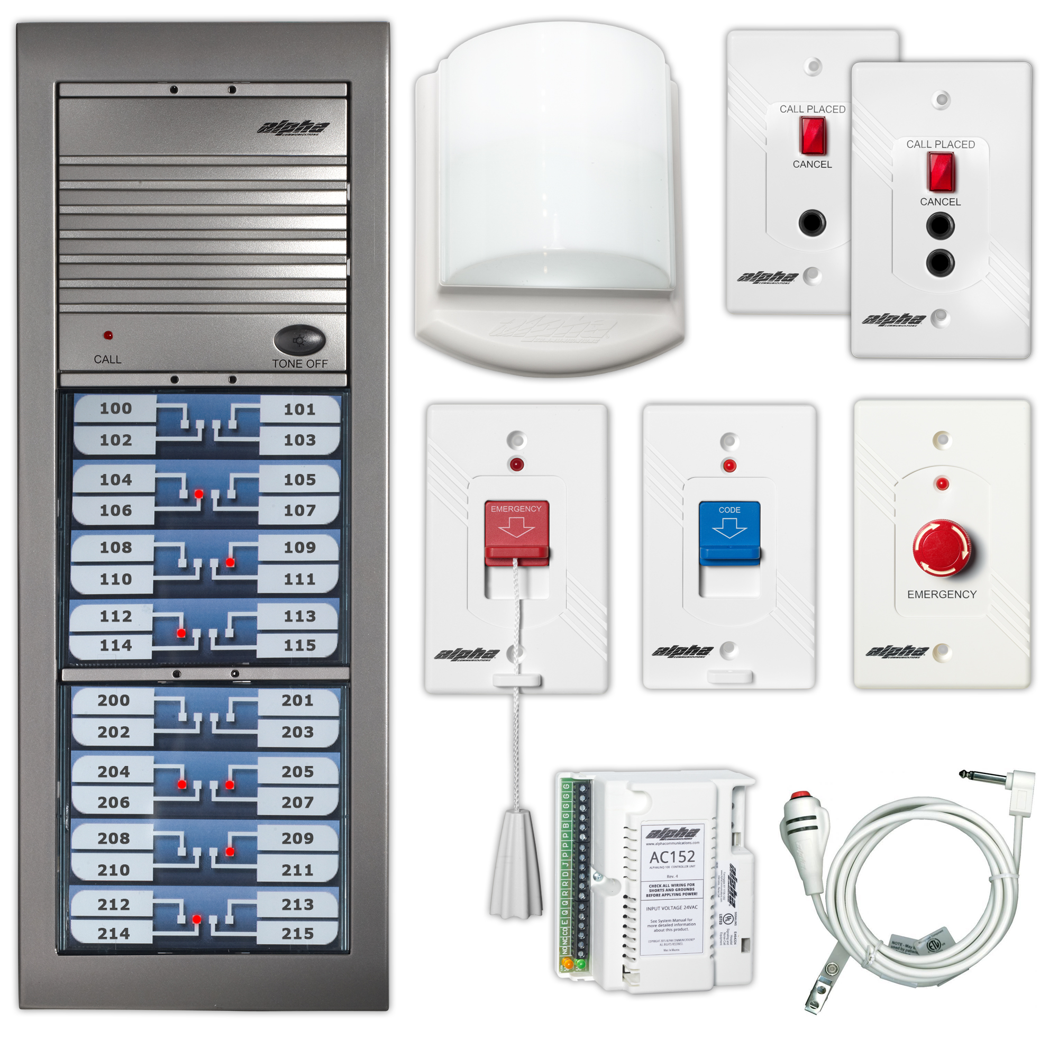
™
100 Series
Audible Visual Nurse Call System
Ideal for hospitals and nursing homes of any size where a U.L. 1069 Listed system is required.
Copyright 2016 Alpha Communications. All rights Reserved.

Slide 2
AlphaLinQ™ 100 Series
The AlphaLinQ 100 Series audible/visual nurse-call system is designed for health-care applications where voice communication is not required, but only tones and lights are needed. The AlphaLinQ 100 Series is U.L. Listed 1069, to the latest standards. You can even add pocket-paging capability as well, to signal staff members that are away from the master station(s).
Copyright 2016 Alpha Communications. All rights Reserved.

Slide 3
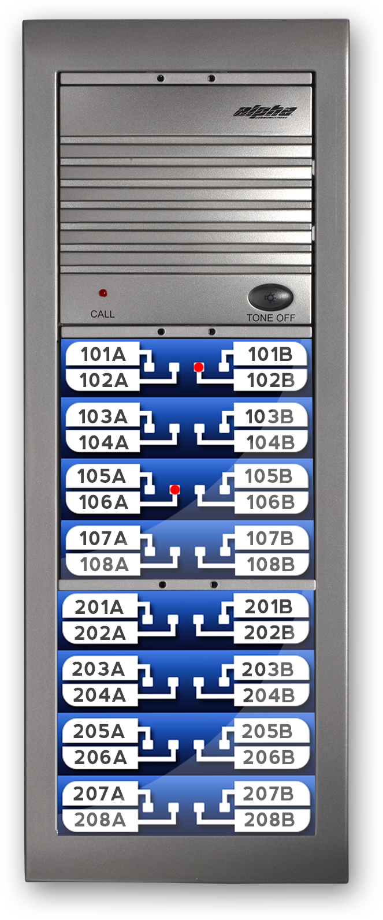
AlphaLinQ™ 100 Series
The Master Annunciator Station(s)
The master annunciators have a compact layout, and can be expanded to virtually any size with our 16-point call-placed LED modules. It can be flush, surface or desk mounted and has built-in tone signal and tone silence button, as required by U.L.
This is a 32-Point Master Annunciator Station
Copyright 2016 Alpha Communications. All rights Reserved.

Slide 4
AlphaLinQ™ 100 Series
The Master Annunciator Station(s)
When a remote station is activated, the master will sound an electronic tone and will light a corresponding LED, indicating the location of the call. The tone signal can be silenced at the master station for non-emergency calls.
The individual LED will remain lighted until the remote station is reset at the point of origination only.
Copyright 2016 Alpha Communications. All rights Reserved.

Slide 5
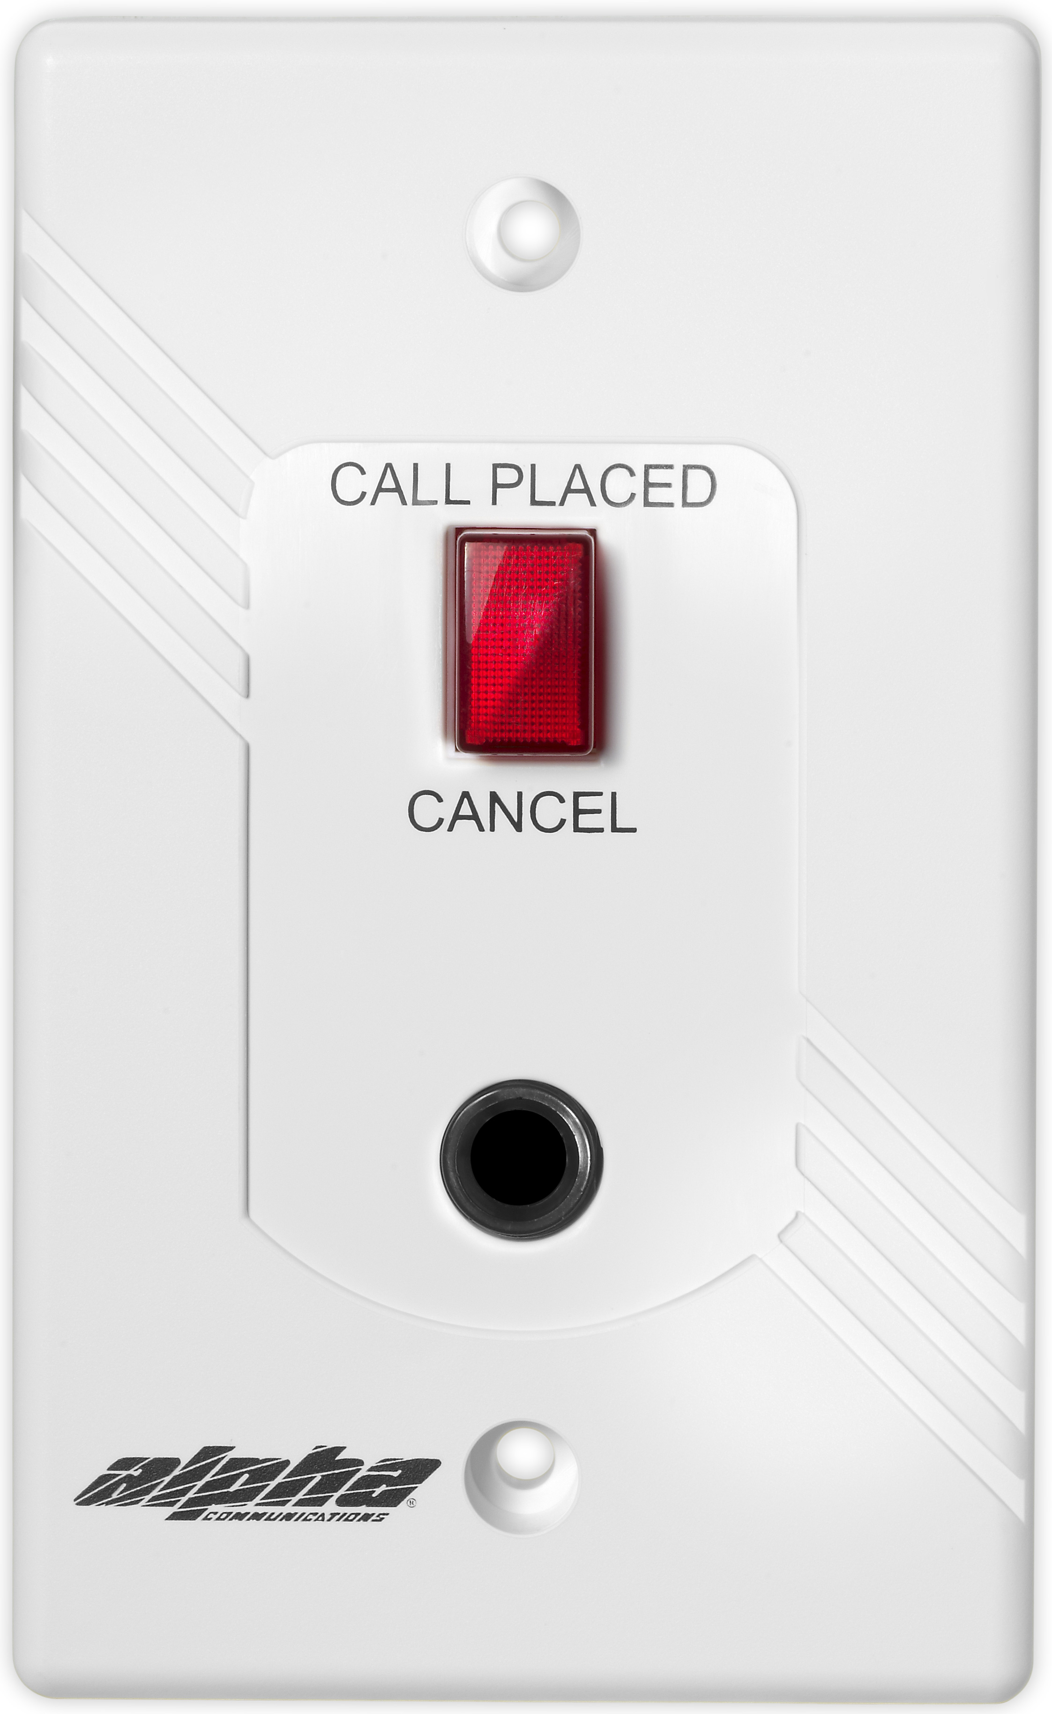
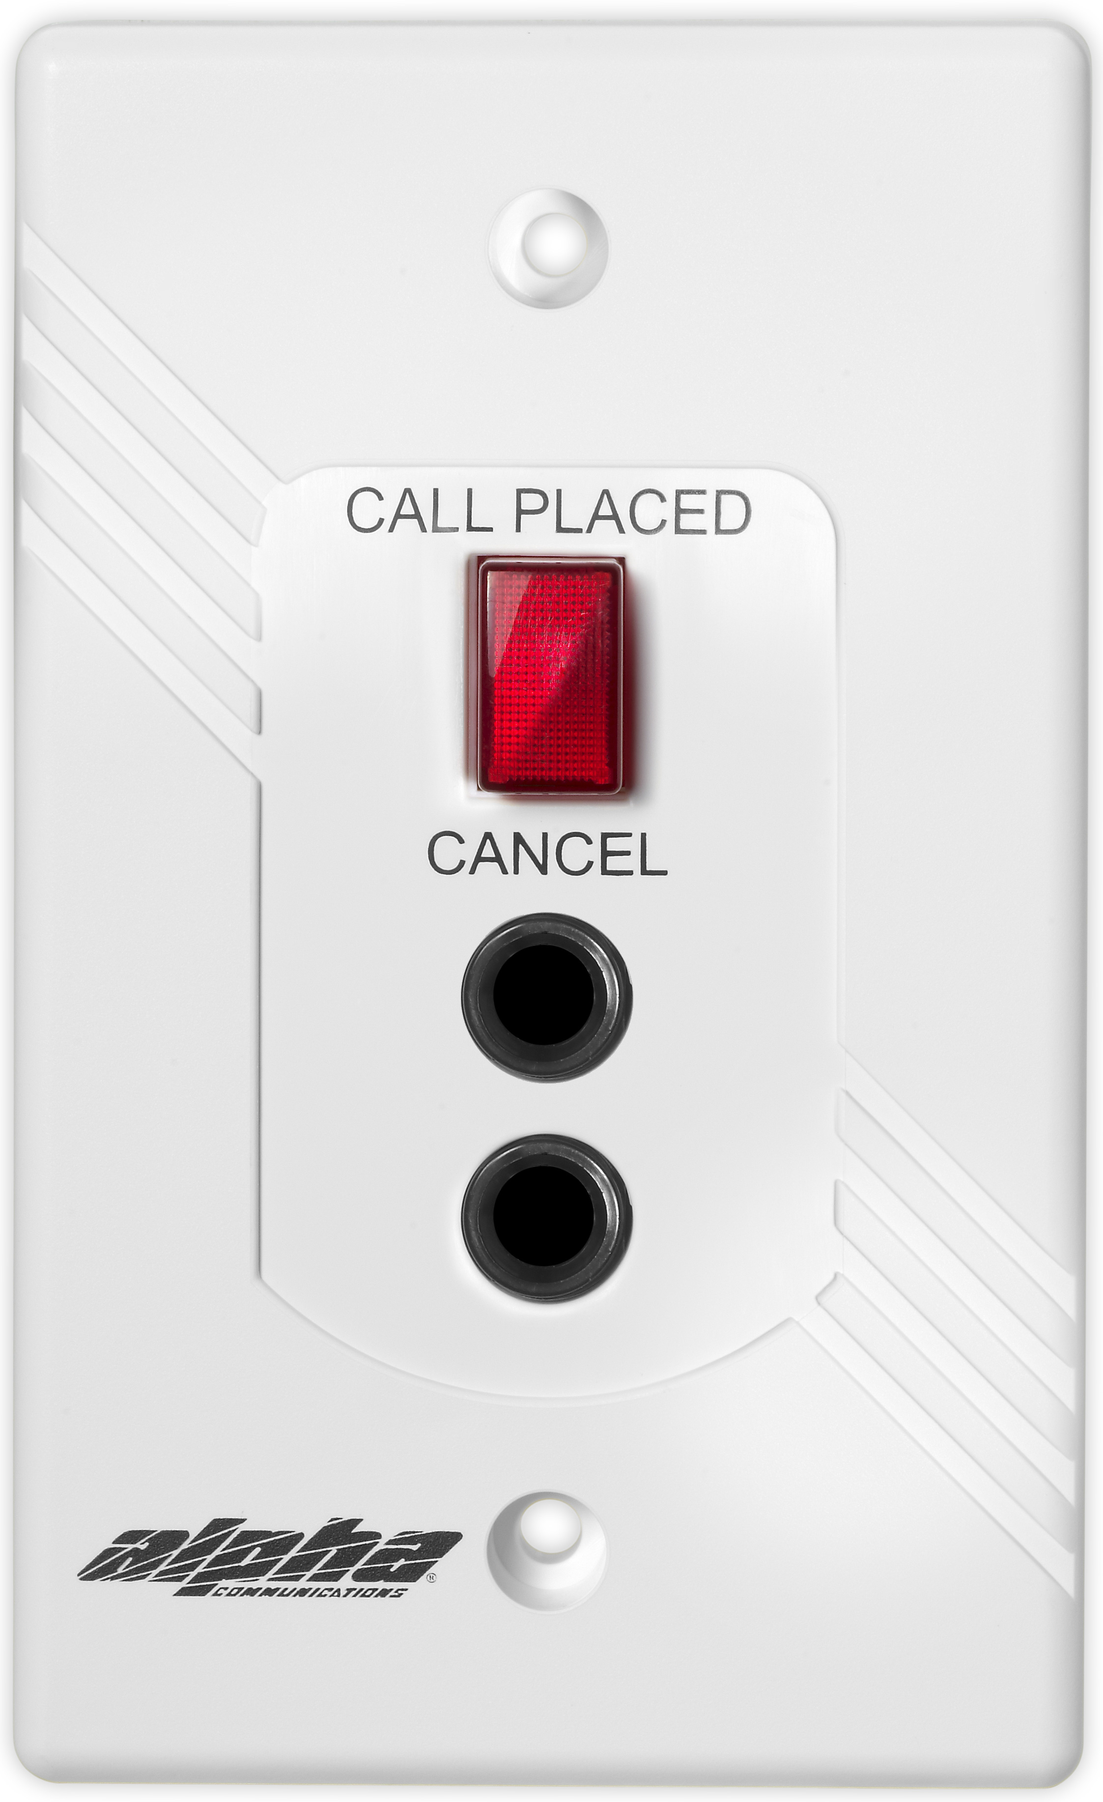
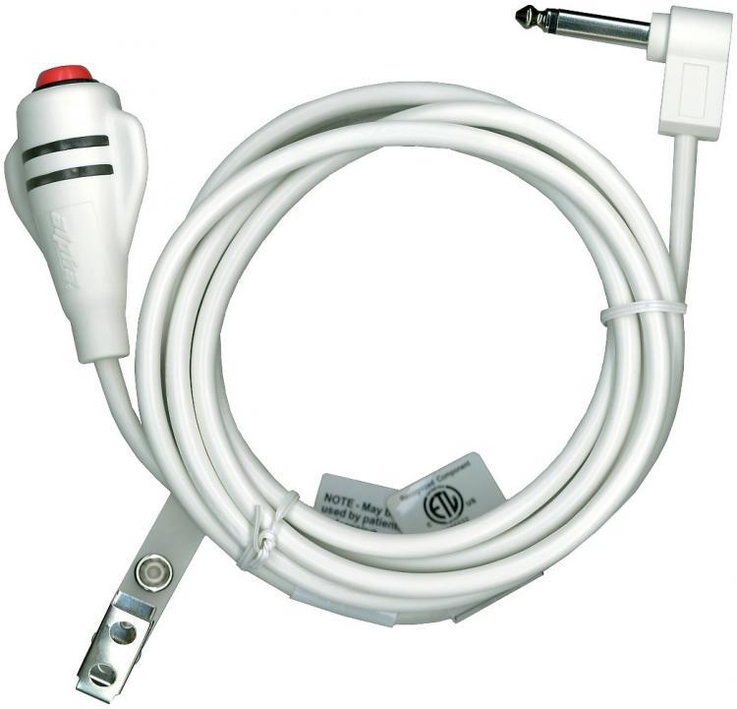
AlphaLinQ™ 100 Series
EPS101 and EPS102 Bed Stations
A routine call is registered at the annunciator panel and corridor light (and corridor zone light if installed) when the call cord button is used, or if the call cord is accidentally removed from the jack.
Copyright 2016 Alpha Communications. All rights Reserved.

Slide 6
AlphaLinQ™ 100 Series
EPS101 and EPS102 Bed Stations
The stations include a lighted 'CALL-PLACED' indicator when a call is placed and a 'CANCEL' button, mounted on rugged ABS white plastic faceplates.
Copyright 2016 Alpha Communications. All rights Reserved.

Slide 7
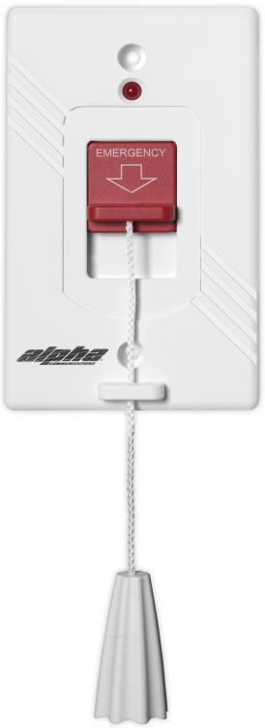
AlphaLinQ™ 100 Series
EPS155 and EPS337 Emergency Pull Cord Stations
The EPS155 Emergency Station may be used in any location where activation of an emergency-level signal is required. It features a built-in Red (flashing) LED, and 6 foot nylon pull cord.
Due to the flexibility of its design, it may be used as a PULL CORD EMERGENCY STATION, or a PUSH TYPE EMERGENCY STATION. The pull cord supplied may be pulled in any direction for emergency call activation or if so desired, the LARGE RED push/pull down lever may be used.
The water-resistant version of this station is the EPS337.
Copyright 2016 Alpha Communications. All rights Reserved.

Slide 8
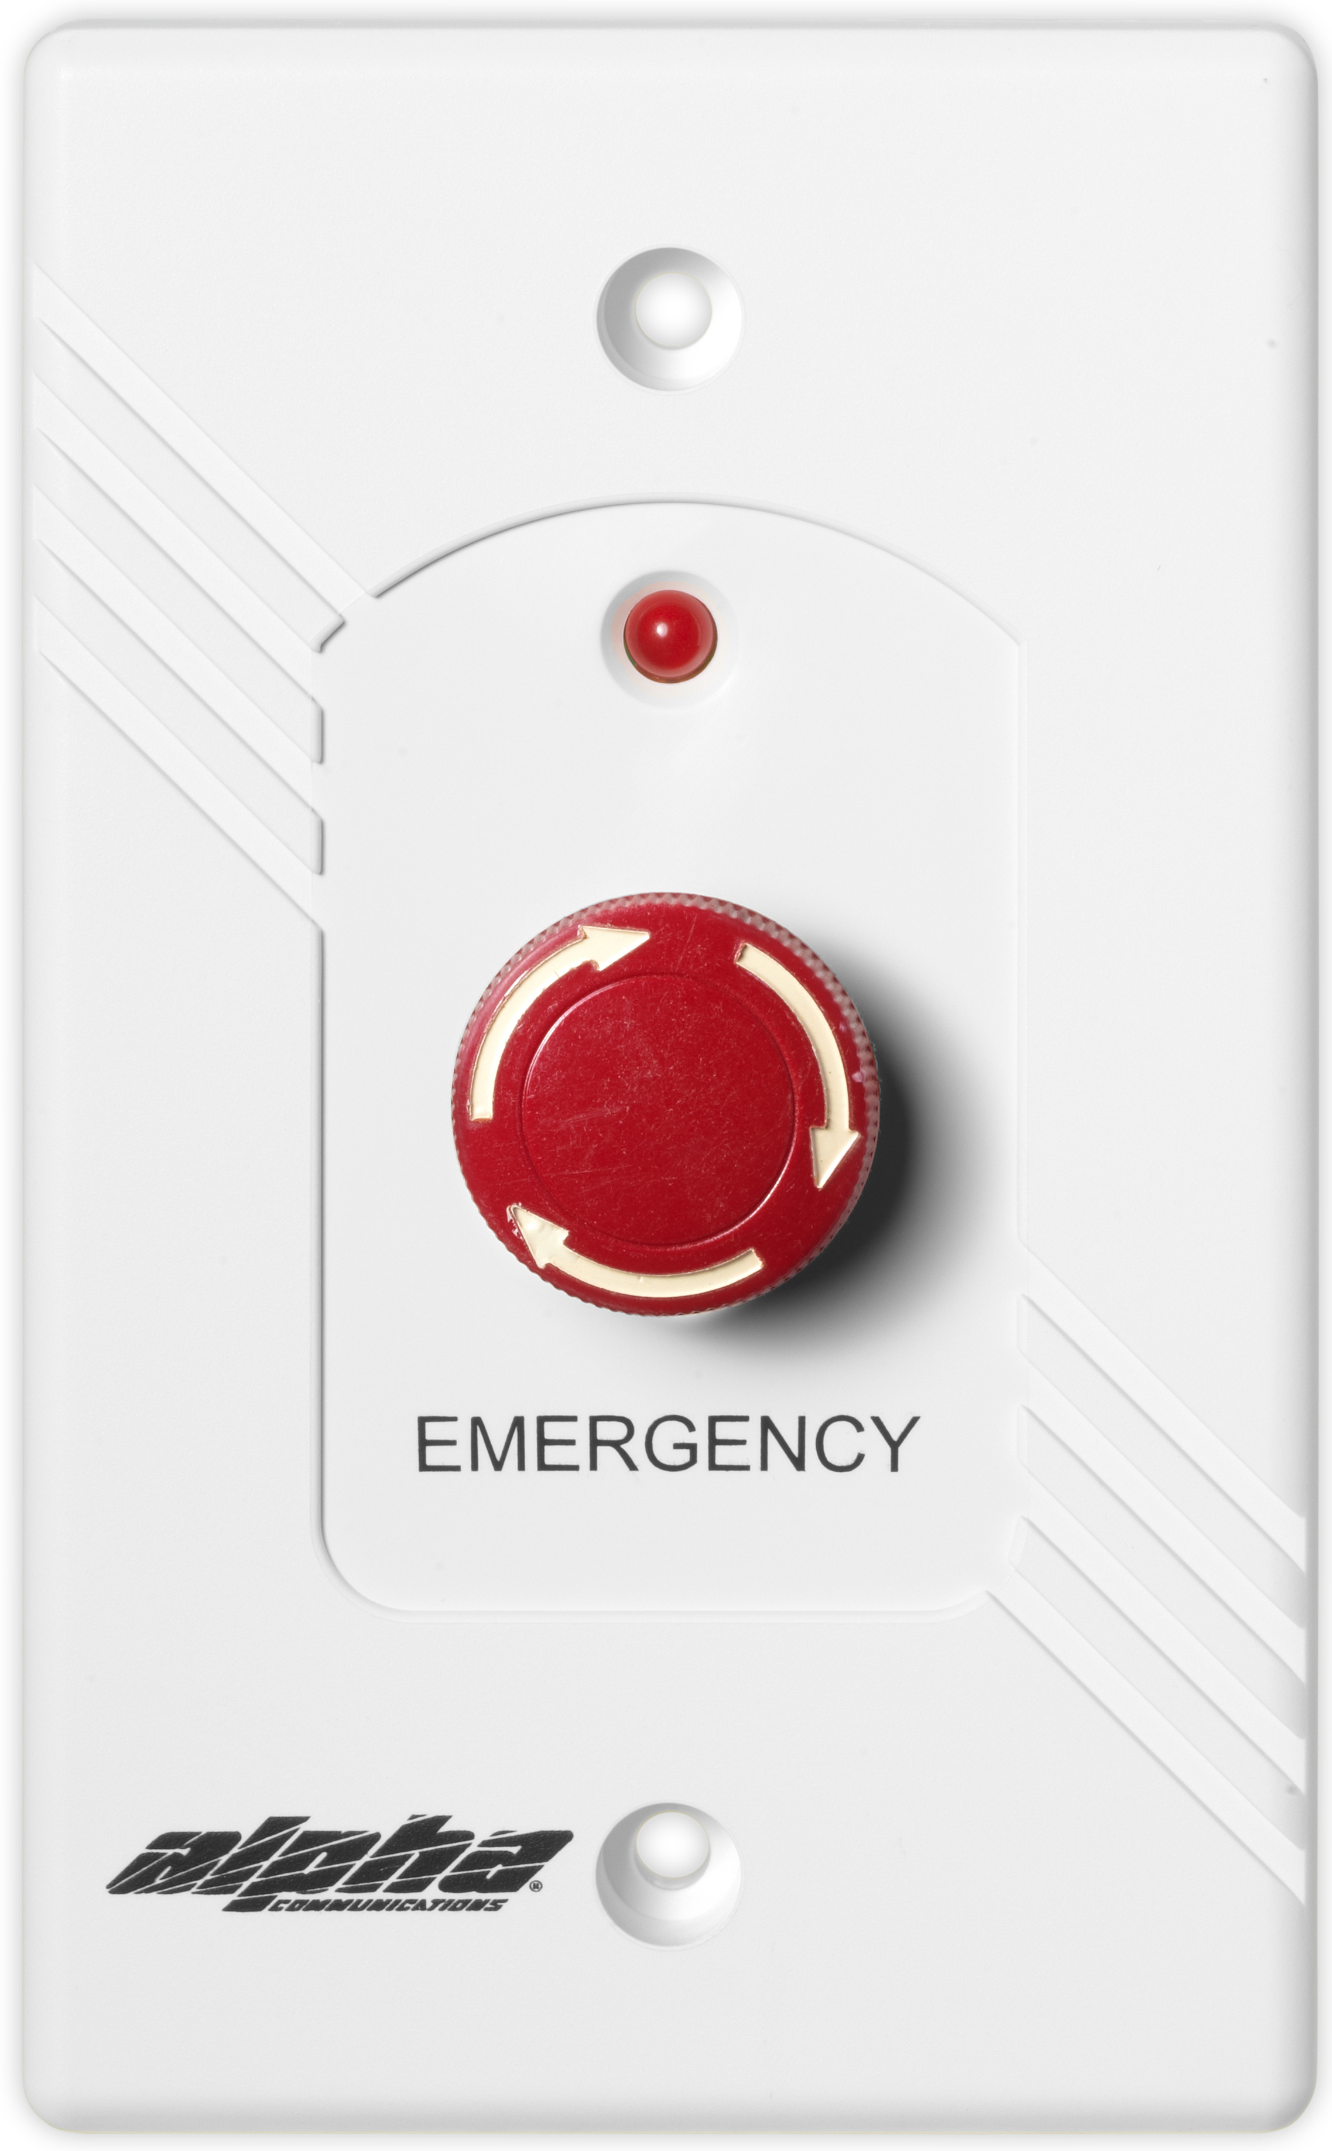
AlphaLinQ™ 100 Series
EPS339 Emergency Push Button Station
The EPS339 functions like an EPS155. It may be used as an emergency station or as a staff assist emergency call station.
The large mushroom-style button is easily activated, so that calls may be placed using an elbow, shoulder, etc., when using the hands is inconvenient or inappropriate.
Calls are cancelled by turning the mushroom-style button clockwise.
Copyright 2016 Alpha Communications. All rights Reserved.

Slide 9
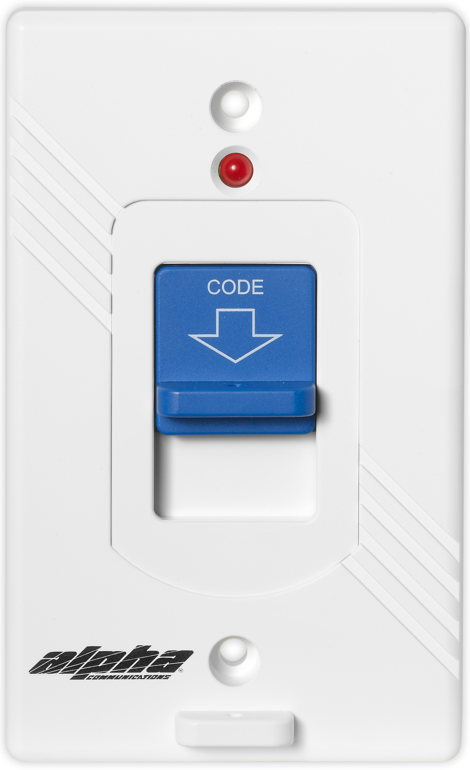
AlphaLinQ™ 100 Series
EPS156 Code-Blue Pull Cord Station
While the EPS156 Code Call / Code Blue Station is designed to indicate a call of extra-high level of priority, it may be used to operate all system code signals (except 'supervised' code blue applications). It may be used independently or connected with other call stations or intercom stations.
Due to the flexibility of its design, it may be used as a PULL CORD EMERGENCY STATION, or a PUSH TYPE EMERGENCY STATION. The pull cord supplied may be pulled in any direction for emergency call activation or if so desired, the LARGE RED push/pull down lever may be used.
Copyright 2016 Alpha Communications. All rights Reserved.

Slide 10
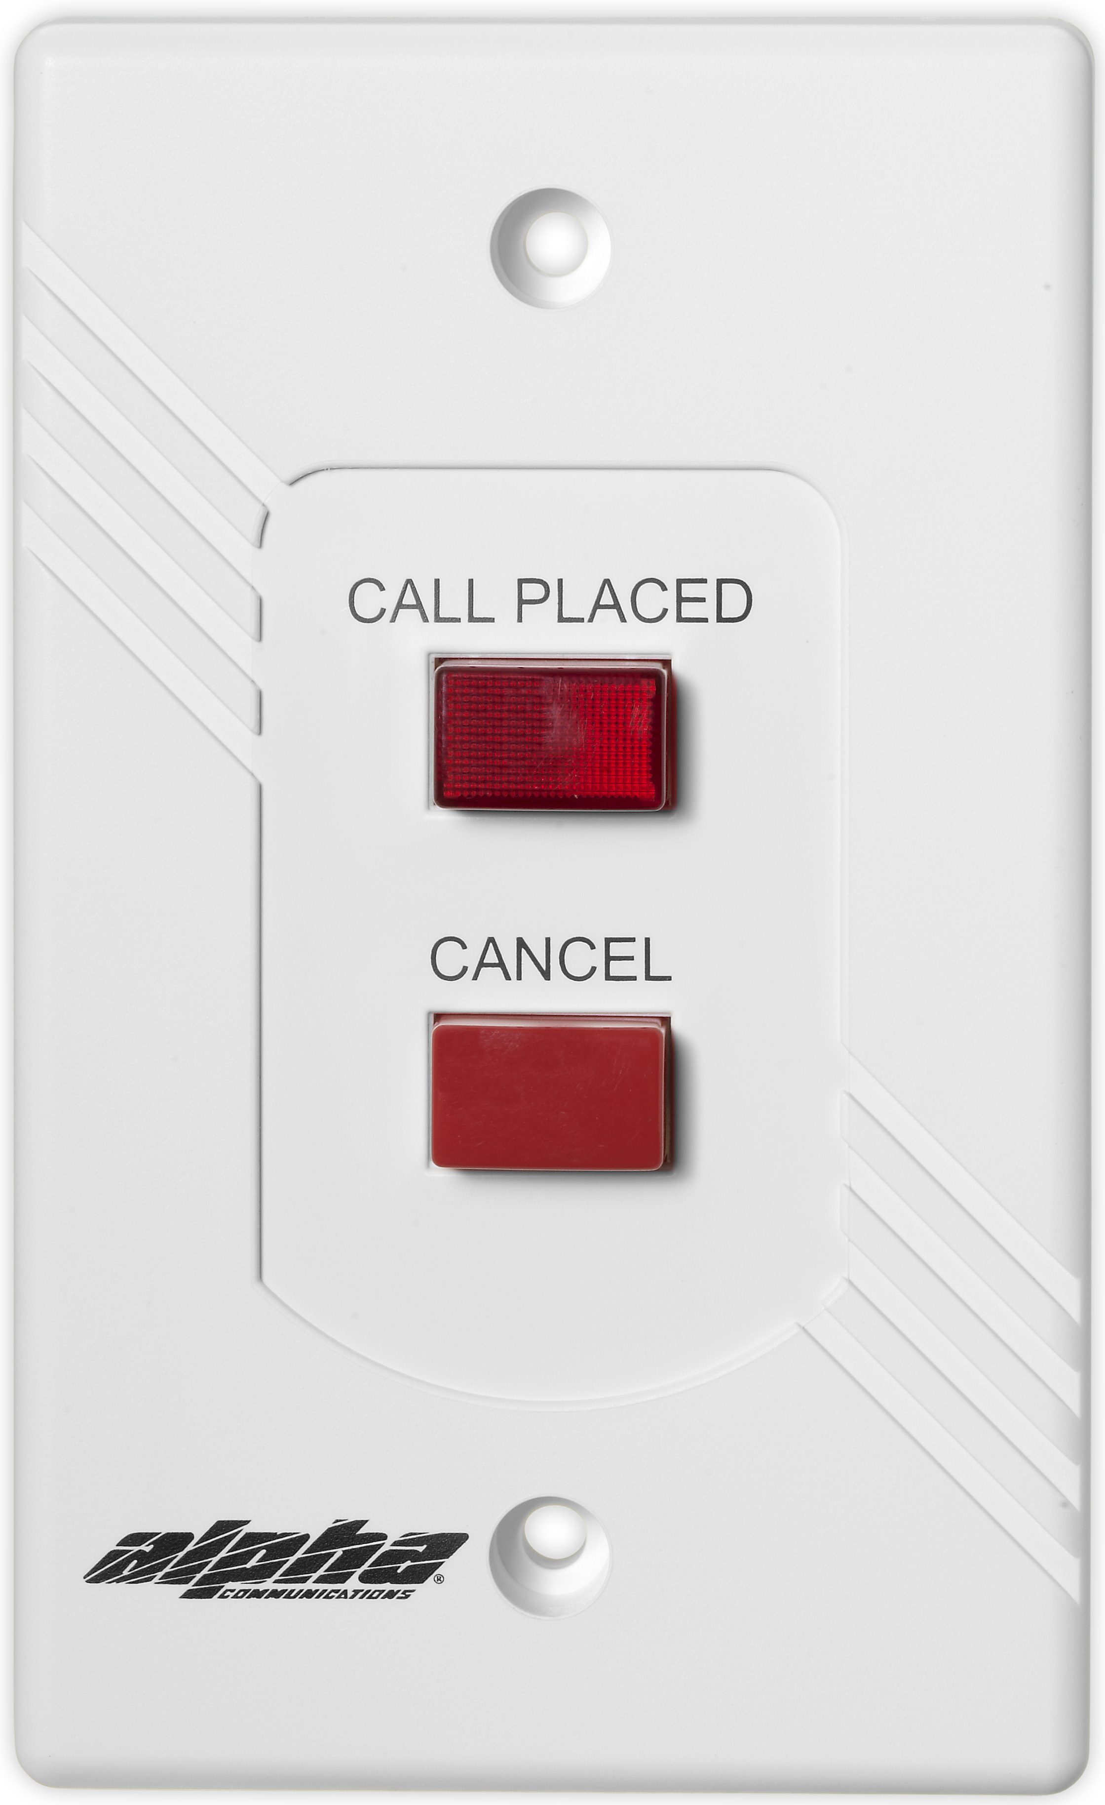
AlphaLinQ™ 100 Series
VSS110 Visual Staff Station
The VSS110 visual Staff Station incorporates push button operation of call and cancel functions. A call is registered at the annunciator panel and on a corridor light or corridor zone light (if installed) when the call switch with integral "CALL PLACED" LED is pushed. The "CALL PLACED" LED is also illuminated.
Calls are cancelled simply by depressing the "CANCEL" button mounted on a rugged ABS plastic faceplate. The "CALL PLACED" LED will also be extinguished.
Copyright 2016 Alpha Communications. All rights Reserved.

Slide 11
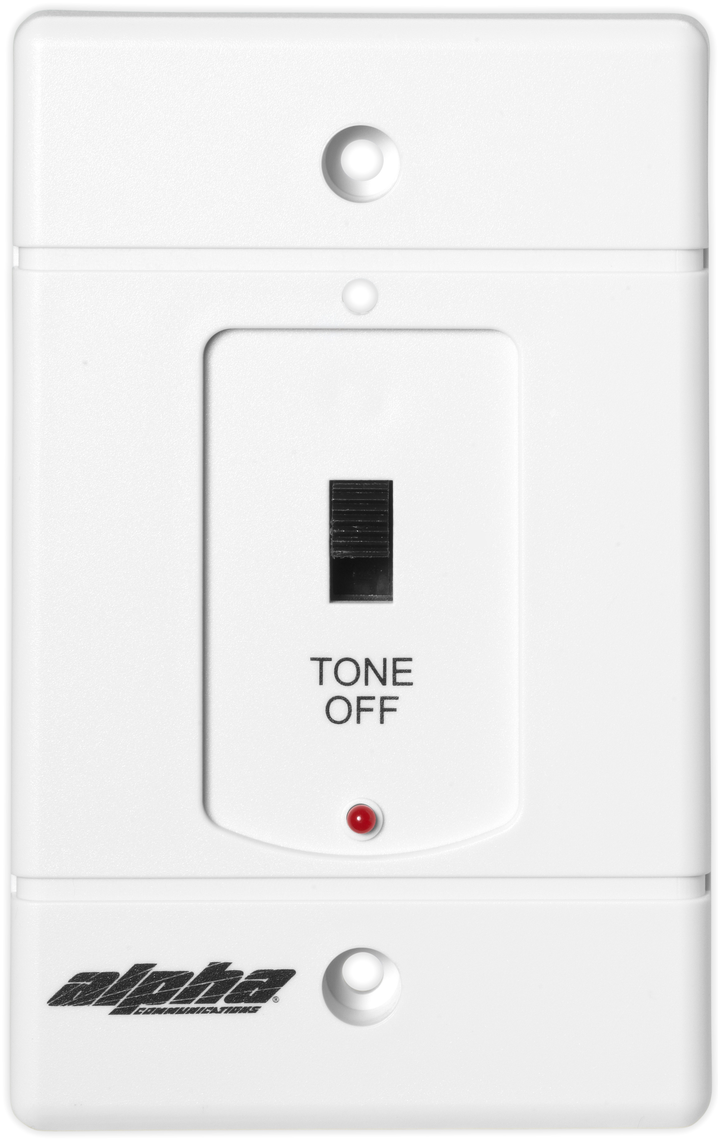
AlphaLinQ™ 100 Series
VDS150 Duty Station
The VDS150 Duty Station provides an indication of incoming calls in work areas away from the Nurse Call Master Control Station(s), and features a built-in Red LED and electronic buzzer.
Normal calls are indicated by a steady light and intermittent tone. Emergency calls take precedence and are indicated by a flashing solid state LED light and a pulsating tone.
A "Tone-Off" slide switch permits silencing of the tone signal for normal calls only.
Copyright 2016 Alpha Communications. All rights Reserved.

Slide 12
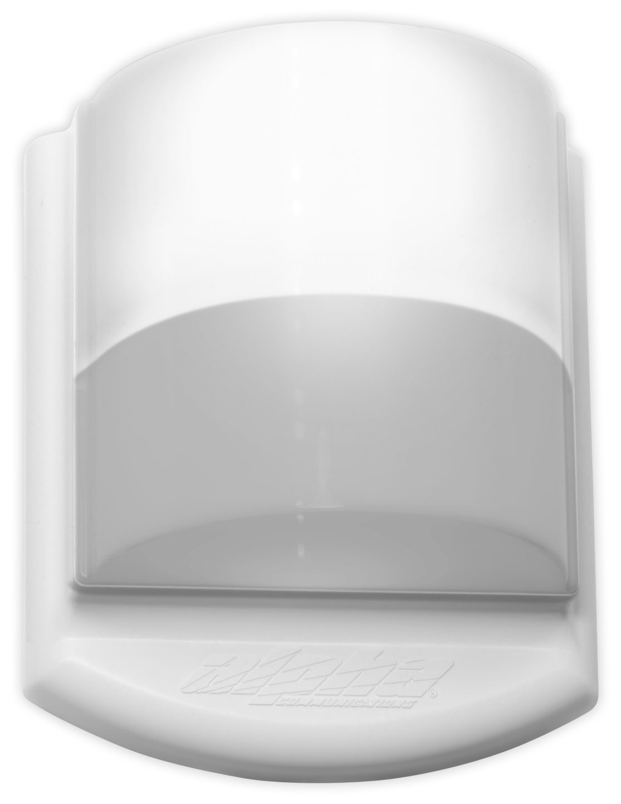
AlphaLinQ™ 100 Series
CDL101LED Corridor Dome Light
The CDL101LED Corridor Dome Light (with single White LED) provides visual indication of any type of call when used with a nurse-call, emergency-call, or for stand-alone signaling applications. Unlike most LED type corridor lights, the CDL101LED can operate on 24VAC OR 24VDC, and not just 24VDC.
Emergency calls are indicated by the rapid flashing of the CDL101LED corridor dome light associated with the calling station. Normal (routine) calls produce a steady illumination.
Copyright 2016 Alpha Communications. All rights Reserved.

Slide 13
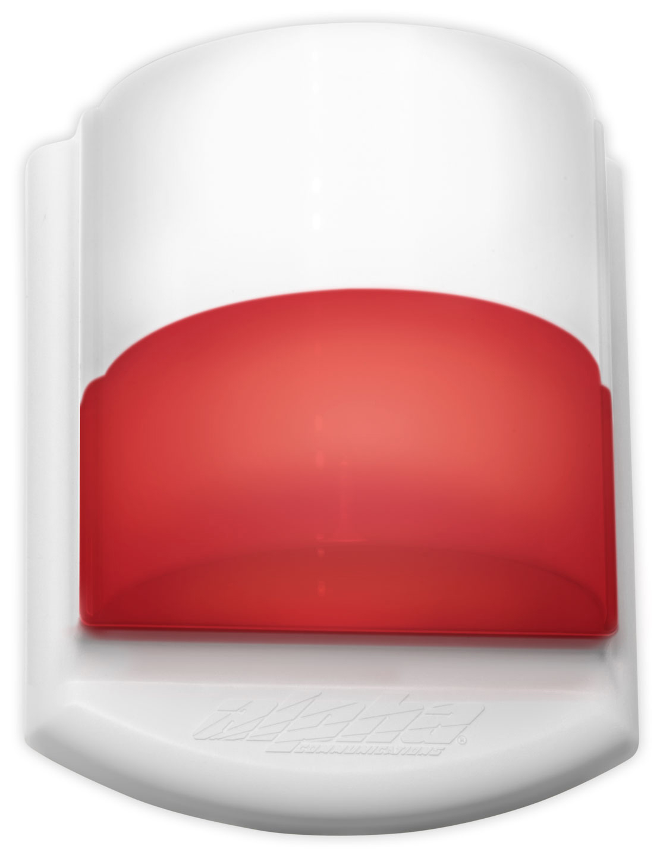
AlphaLinQ™ 100 Series
CDL102LED Corridor Zone Light
The CDL102LED Corridor Dome Light (with single White LED and single Red LED) provides visual indication of any type of call when used with a nurse-call, emergency-call, or for stand-alone signaling applications. Unlike most LED type corridor lights, the CDL102LED can operate on 24VAC OR 24VDC, and not just 24VDC.
The CDL102LED corridor zone/dome light can be used as a 2-color Zone Light, or for special applications can be used as a 2-color Dome Light. When used as a Zone Light, the CDL102LED White LED indicates a Regular or Routine call priority, and the Red LED indicates an Emergency priority.
Copyright 2016 Alpha Communications. All rights Reserved.

Slide 14
AlphaLinQ™ 100 Series
CDL101LED and CDL102LED
The CDL101LED and CDL102LED can also be used with our other emergency-call and/or signaling system(s), or even those from other manufacturers.
Both models mount on a standard 1 or 2-gang electrical back box and feature a long-life, high brightness pure White LED, eliminating the need for costly bulb replacements, and for maximum call indication.
Copyright 2016 Alpha Communications. All rights Reserved.

Slide 15
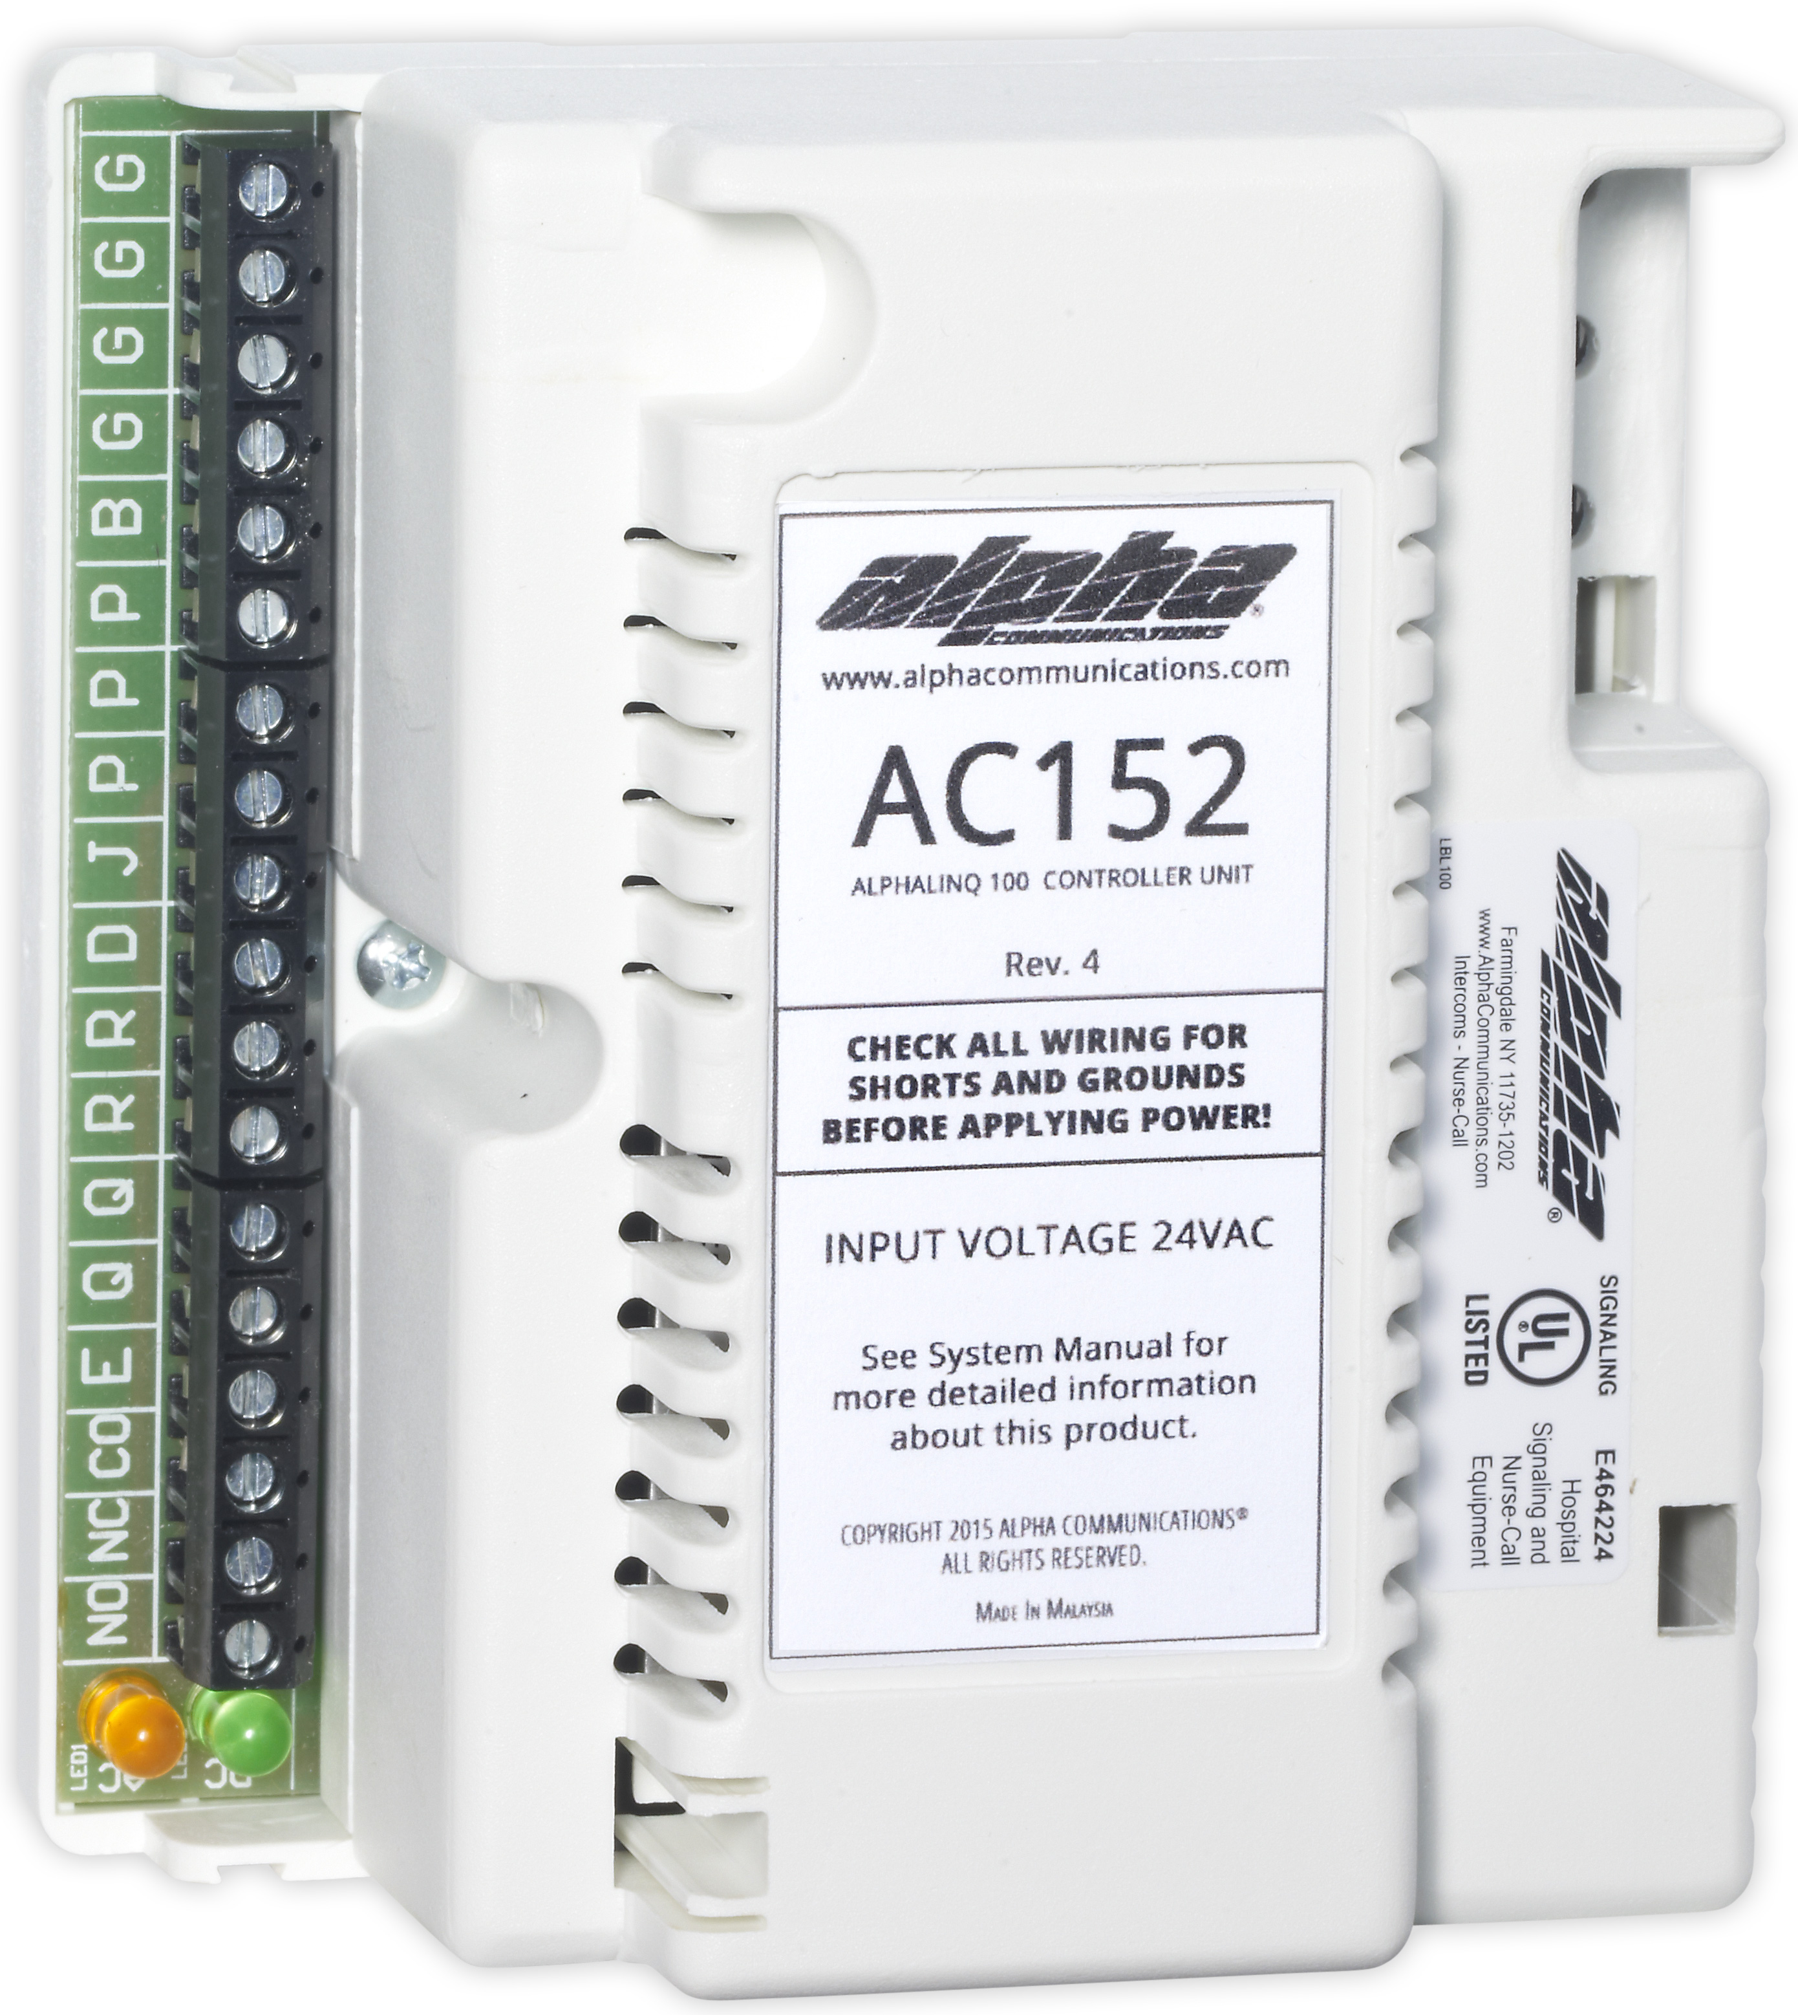
AlphaLinQ™ 100 Series
AC152 Annunciator Control Unit
The AC152 annunciator control unit is used to provide power and control circuits to operate the AlphaLinQ™ 100 series visual nurse-call system, but can be used and is backwards compatible with some older systems as well. It contains the electronic circuitry necessary to detect the presence of routine and emergency calls, and to generate audible and visual control signals.
It provides steady or intermittent voltages to operate visual signaling devices. The AC152 supports up to 1 amp of current load from the field devices, and supports interconnection of a secondary power supply to increase the output current load to 3 amps. Protective circuitry has been incorporated to protect routine and emergency call commons from shorts.
The AC152 also feature a built-in battery charging circuitry, and a Form 'C' dry contact relay which will activate when system calls are placed.
Each master station requires it's own AC152 for power and control.
The AC152 is U.L. 1069 listed, to the latest standards.
Copyright 2016 Alpha Communications. All rights Reserved.

Slide 16
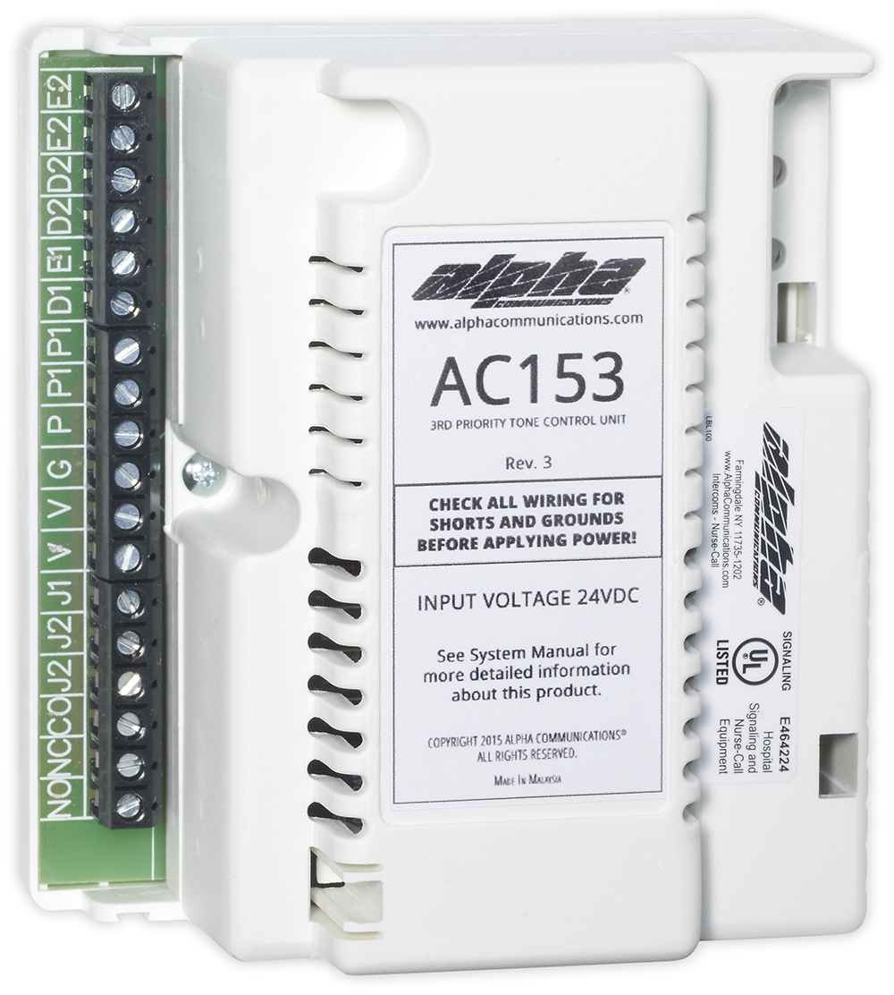
AlphaLinQ™ 100 Series
AC153 3rd Priority Annunciator Control Unit
The AC153 3rd Priority Annunciator Control Unit is used to provide a third level of signaling priority, for applications such as fire/heat/smoke detection and/or code call capabilities with the AlphaLinQ™ 100 series visual nurse-call system, but can be used and is backwards compatible with some older systems as well.
One AC153 is required per system, in addition to the AC152 control unit(s).
No additional transformer is required. The AC153 contains the electronic circuitry necessary to detect the presence of 3rd priority calls, and to generate audible and visual control signals. It provides rapidly pulsating voltages to operate visual signaling devices.
The AC153 also features a built-in Form 'C' dry contact relay which will activate when 3rd priority system calls are placed.
The AC153 is U.L. 1069 listed, to the latest standards.
Copyright 2016 Alpha Communications. All rights Reserved.

Slide 17
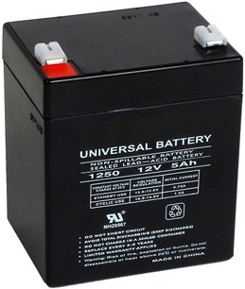
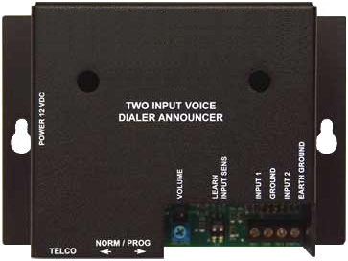
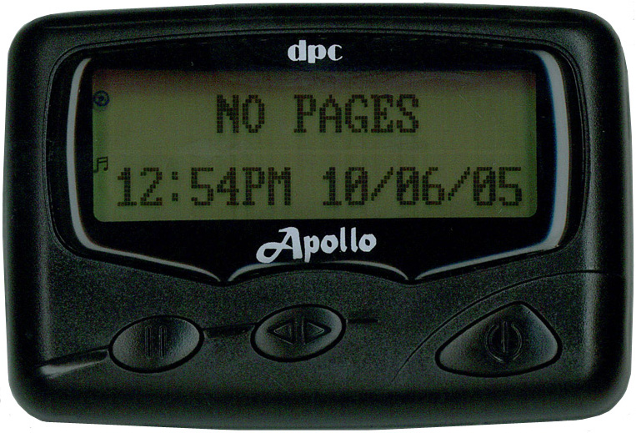
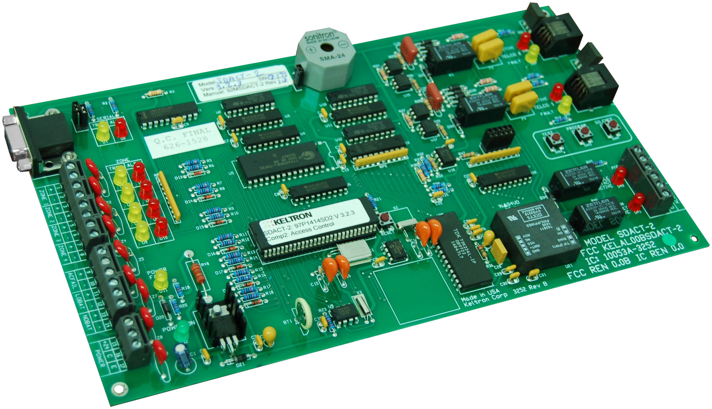
AlphaLinQ™ 100 Series
Other Options
Central Station
Connectivity
Battery Backup
Alphanumeric
Pocket Paging
Digital Serial
Dialing
Copyright 2016 Alpha Communications. All rights Reserved.

Slide 18
AlphaLinQ™ 100 Series
For more information on this system, please visit:
The AlphaLinQ™ 100 Series System Information Page
Spec Sheets
Wiring Information
Downloads
Literature
Click to Configure Your AlphaLinQ™100 System with AlphaQuote™
42 Central Drive – Farmingdale NY 11735-1202
P: 800-666-4800 F: 631-777-5599
http://alphacommunications.com/
Copyright 2016 Alpha Communications. All rights Reserved.

